Slide 1
Saint2 Overview
David Anthony
david.c.anthony@aptiv.com

Slide 2
Topics
Student Developers (only)
TortoiseSVN
Mantis
FreeNAS \\10.207.142.31\Public
Wiki: http://sdt52.usinkok.northamerica.delphiauto.net/wiki/index.php/SAINT2
Overview
Saint2
Bytes in a message
Header Byte
Header Byte Decode
CAN ID
Completion Code

Slide 3
Topics (con’t)
Time Stamp
CAN Configuration
Other busses
PC
Saint Bus Engine (SBE)
Saint Bus Monitor (SBM)
Tx\Rx
Periodics
Emulation

Slide 4
Topics (cont’d)
Views
.dbc file decode
Make your own
Visual Studio
VB
C++
C#
Excel

Slide 5
Serial Bus Interface Tool – System Diagram
Purpose: To provide an interface to a serial bus for a user, a test application, or another controller

Slide 6
Serial Bus Interface Tool – General Features
User can interface with multiple buses concurrently with a single tool
Host interface is USB or RS232
The SAINT2 hardware is host and SD card configurable
The SAINT2 can be configured to send out periodic messages without a PC interface
The SAINT2 can be configured to act as a “gateway” between certain serial buses without a PC interface
The host can interface with discrete trigger out and trigger in pins

Slide 7
Multiple Protocols
CAN (Block Transfer, ISO-15765-2)
Single Wire
Dual Wire
FT CAN
Class2 (J1850)
LIN
Keyword
SPI
IIC
Trig In\Trig Out

Slide 8
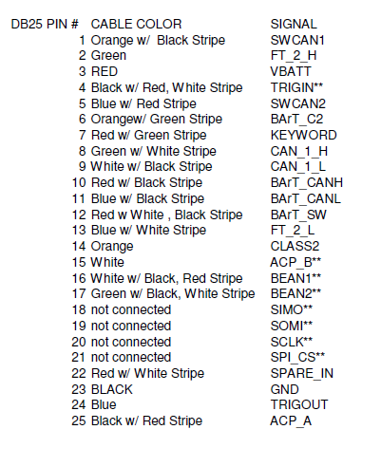
Connections

Slide 9
CAN features
CAN\CAN gateway
CAN\RS-232 Gateway
CAN listen only mode (No ACK)
Transceiver control
Normal, Standby, Sleep, High Speed, High Voltage
ID filtering
Reduce PC loading
Bus Flooding
ISO-15765-2 Transport protocol

Slide 10
SAINT2 The SAINT2 Header Byte Format
SAINT2 Header Byte Format
Bits 7 – 3 | Bit 2 | Bit 1 | Bit 0
Protocol ID | Command indicator bit | Tx/Rx indicator bit | Time Stamp Included bit
See Protocol ID table | =0: message is to be send or was received on the serial bus =1: message is a protocol related SAINT2 command or report | =0: message was received from the serial bus =1: message was transmitted by the S2 onto the serial bus | =0: the message does not contain a time stamp =1: a 2 byte time stamp is included in the message
SAINT2 Protocol IDs
SAINT2 Config Command | $08
IIC | $20 ($20 - $27)
KW2K | $28 ($28 – 2F)
CAN Node 1 | $50 ($50 - $57)
CAN Node 2 | $58 ($58 - $5F)
Class 2 | $60 ($60 - $67)
SPI | $78 ($78 – $7F)
LIN | $B8 ($B8 - $BF)
ISO15765-2 TP Node 1 | $C0 ($C0 – C7)
ISO15765-2 TP Node 2 | $C8 ($C8 – CF)
$61 XX XX… → A Class 2 message received on the bus with a time stamp
$53 XX XX… → A CAN Node 1 message transmitted onto the serial bus with a time stamp
$5C XX XX… → A CAN Node 2 configuration command
Examples

Slide 11
SAINT2 The SAINT2 Message Format
Serial Message
($7DF 023E800000000000)
Completion Code
(Successful RX)
SAINT2 Header
(CAN 1 RX msg)
2 Byte Time Stamp
($2367)
$51 07 DF 02 3E 80 00 00 00 00 00 10 23 67
SAINT2 Header
indicates serial bus
For Tx – must be pre-appended to the serial message by the user/plug-in
For Rx – will be pre-appended to the serial message by the SAINT2 HW
Serial Message
Actual serial message tx’d/rx’d on the serial bus
Completion Code
A protocol specific byte indicating the success or error in the message tx or rx
Appended to the serial message by the SAINT2 HW
For CAN 0x08 successful Tx, 0x10 successful Rx
Errors
Time Stamp
2 bytes – 1ms/bit resolution
Only included in the message if the SAINT2 header is odd
Appended to the serial message by the SAINT2 HW

Slide 12
11-bit vs. 29-bit CAN messages
MSB of second byte set for 29-bit, off for 11-bit
1st byte after header
11-bit
000h-7FFh
2 Bytes of ID
29-bit
0000 0000h – 1FFF FFFFh
4 Bytes of ID
Header | B2:b7-b3 | B2:b2-b0, B3 | Bytes 4-11
50/58 | 00000 | b₁₀-b₀ | D1-D8
Header | B2:b7-b5 | B2:b4-b0, B3, B4, B5 | Bytes 6-13
50/58 | 100 | b₂₈-b₀ | D1-D8

Slide 13
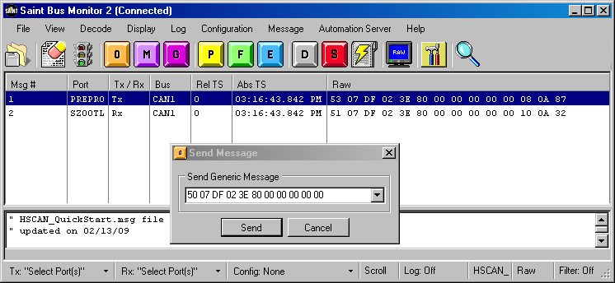
SAINT2 How to TX/RX a Serial Message
In this example: the CAN message is transmitted from PREPRO (CAN 1) and received on SZ00TL (CAN 1)
User types in → $50 07 DF 02 3E 80 00 00 00 00 00
2 Byte Time Stamp
($0A87)
SAINT2 Header
(CAN 1 TX msg)
Completion Code
(Successful TX)
Transmit message is displayed as → $53 07 DF 02 3E 80 00 00 00 00 00 08 0A 87
SAINT2 Header
(CAN 1 RX msg)
Completion Code
(Successful RX)
2 Byte Time Stamp
($0A32)
Receive message is displayed as → $51 07 DF 02 3E 80 00 00 00 00 00 10 0A 32
Same CAN message!
Why are the time stamps different?
The 2 SAINT2s don’t share a clock!
Send Message Button
SAINT2 serial numbers
Transmit message displayed
Enter SAINT2 Header
Enter Serial Message
Receive message displayed

Slide 14
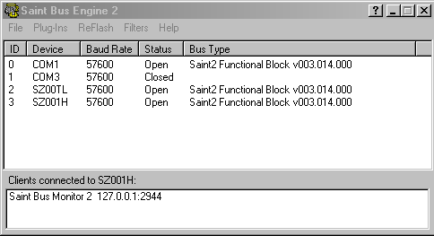
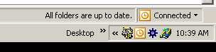
SAINT2 Host Software SAINT Bus Engine 2 – A Closer Look
Plug-ins – select to execute an installed plug-in (must be installed in c:\program files\saint bus engine2\plugins)
Re-flash – select SAINT2 to launch the plug-in to reflash the SAINT2 firmware
Filters – set up filters to reduce number of messages passed to the plug-ins – good for busy buses or slow plug-ins (VB)
Device – Connected SAINT2 device. If it doesn’t show up here – make sure the correct USB driver is installed
Bus Type – displays the SAINT2 firmware version running on the SAINT2
Baud Rate – host interface baud rate NOT the serial bus baud rate – don’t bother to try to modify it – you can’t
Status – indicates if the device connection is open or closed – must be open to use – double click here to open or close the device
Don’t shut down the SBE2 – it must remain running!
If the SBE2 is running, restore its window using the icon in the system tray

Slide 15
SAINT2 Configuring the SAINT2 box
How does the SAINT2 know what bus you want to send your message out on? What about the baud rate? What about the bus transceiver? →
THE SAINT2 MUST BE CONFIGURED!!
CAN Configuration
Baud rate configuration
Transceiver selection (Dual wire HS, SWCAN, FTCAN)
Transceiver configuration (high speed, high voltage, normal, sleep…)
Special protocol options (no ack error retries, listen only)
ISO15765-2 TP Configuration
CAN IDs
Frame padding
Flow control options
Class 2 Configuration
Normal vs. high speed
Send break signal
KW2K
Operating mode
Baud rate
Header and addressing configuration
Initialization mode
Protocol timing
Etc…
LIN
LIN version
Baud rate
Enable Automatic checksum generation
Set up slave responses
SPI and IIC
See SAINT2 Programmer’s Reference for caveats – these are not general purpose implementations

Slide 16
SAINT2 The SAINT2 Header Byte
How do you indicate the serial bus you want your message transmitted on? How does the SAINT2 box indicate the serial bus it received a message on?
IT’S IN THE SAINT2 HEADER BYTE!!
Every transmitted and received message must have a SAINT2 header byte
The SAINT2 header byte indicates the message’s serial bus in b7 – b3
The SAINT2 header also indicates other useful information in b2 – b0
Is the message a protocol configuration command or report?
Was the message transmitted onto or received from the serial bus?
Is there a timestamp included in the message?

Slide 17
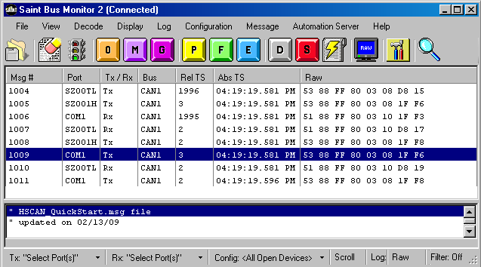
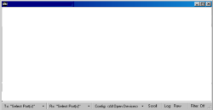

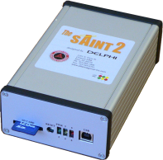

SAINT2 PC Software SAINT Bus Monitor 2
SAINT Bus Monitor 2
Custom User Apps
API
SAINT Bus Monitor 2
Scrolling Message Monitor
Transmit/Receive Messages
Message Filtering
Message Scripting
Message Emulation
Message Logging
See SBM2 Help for more detail

Slide 18
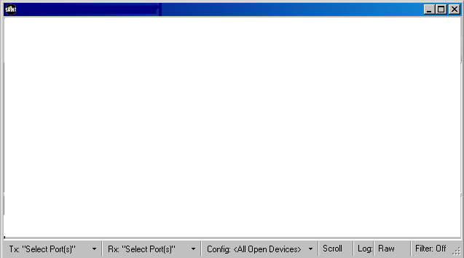
SAINT2 PC Software Custom User Plug-ins
Custom User Plug-ins
Custom User
Plug-in
Custom User Apps
API
Plug-ins
Custom – build it to do what you need it to do
Development Environments supported
VC++
VC#
VB / Excel VBA
Templates\Instructions online

Slide 19
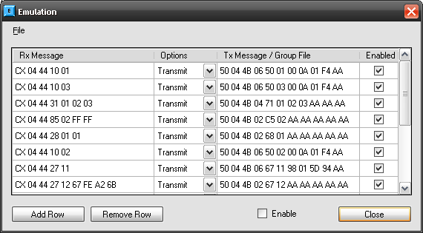
SBM Emulation
Automatically respond to incoming messages with either group file or single message
Simulate another product
WildCards – Just like Filters
X – don’t care nibble
x – don’t care bit

Slide 20
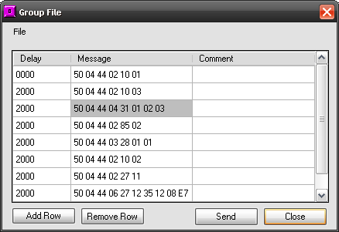
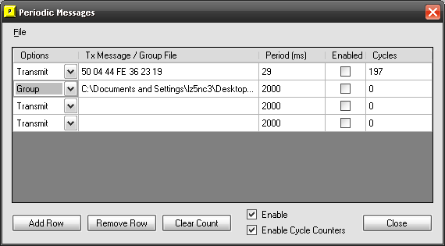
SBM Group Files and Periodics
Group
Periodic
Single
Group

Slide 21
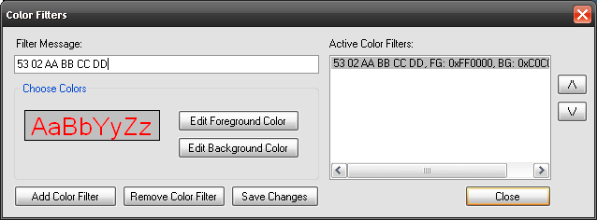
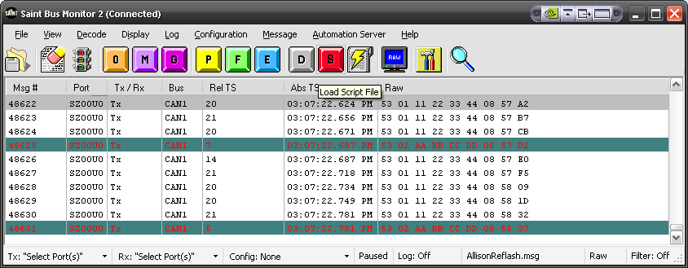
SBM2 Color Filtering
Simply Double Click a message to assign

Slide 22
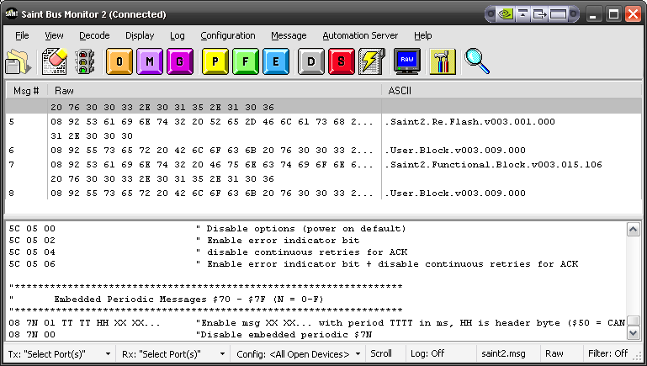
SBM2 – Message File
List of often used messages entered in a text file (*.msg)
Alleviates need to keep typing in the same messages
Double Click to Send

Slide 23
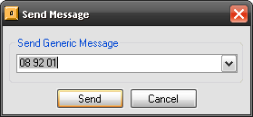
SBM2 – Misc
Send a message
Log Data
Raw
Decode (Protocol aware, ID, etc)
Short
ASCII
WYSIWYG

Slide 24
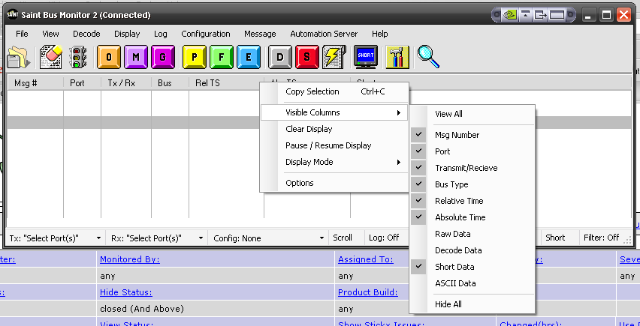
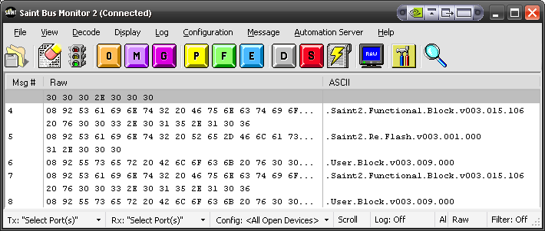
Visible Columns\WYSIWYG
Right Mouse Click on Columns (just like Outlook\Explorer)
Multiple Views at Once

Slide 25
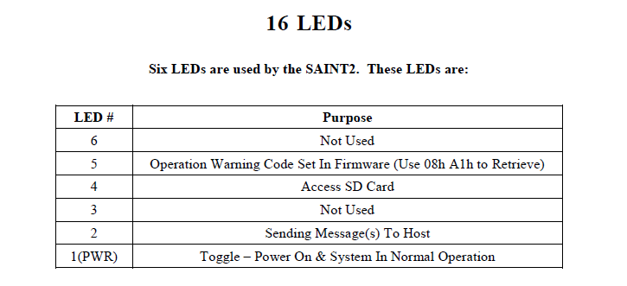
Saint2 LEDs

Slide 26
Other
SBM Features to Demo
Fixed Position Messaging
.dbc file decoding
Not covered today
CAN ISO-15765
Stand-alone SD card configuration
LIN, Keyword, SPI, IIC
Gateway
Reflash
See Programmer’s Reference

Slide 27
SAINT2 Special Features Embedded Periodic
Simple 08 90 message
08 90 T1 T2 HH XX XX
Up to 16 embedded periodic messages (70-7F)
Applications:
Use for product keep alive
Emulate “missing” bus nodes
Advantages:
Message periods are controlled by the SAINT2 firmware – no PC delays
No PC needed – can also be configured with SD card/config.txt
$08 73 00 07 D0 50 07 DF 02 3E 80 00 00 00 00 00 → S2 will send a $7DF 023E800000000000 every 2 seconds
Configuration Command | Description
$08 7X 00 T1 T2 HH YY YY YY … | Turn periodic message 7X ON (X = 0 to F) T1 = MSB of 1ms/bit periodic time T2 = LSB of 1 ms/bit periodic time HH = SAINT2 Header (i.e. $60 for Class2, $50 for CAN) YY = Serial Message (1 to 15 bytes)
$08 7X 00 | Turn message 7X ON after it has already been configured
$08 7X 01 | Turn periodic message 7X OFF
$08 7X 10 | Delete periodic message 7X

